Slide 1








FS Reference
EXECUTIVE SUMMARY
BCN PEG FS center of excellence
Delivered 150+ FS cases in ’23-24
Expertise in FS market modelling
Experience and expertise
We have unrivalled PE deal experience; we mobilize sector and functional expertise and understand the trends disrupting the FS sector
% OF CASES
Expertise in creating in-depth market size models containing precise current estimates and reliable future forecasts. Examples include:
Dedicated resources
Our dedicated FS practice assures high quality and well-trained teams
Global specialty insurance brokerage:
Global GWP and Brokerage revenue model split by LOBs
Proprietary insights faster
We have deep primary research and advanced analytic capabilities, enabling us to get at better insights faster
Wealth management:
Market size and revenue pool estimation in terms of AUMs split by channel and customer segment
Access to cutting-edge data
We leverage a wide variety of data sources through an ecosystem of data partners to generate accurate and reliable insights for clients
Fund administration, Trust and Corporate Services (T&CS):
Market size estimation and forecasts split by geography, type of fund and jurisdiction
Broader partnerships with data partners
BCN PEG delivers an end-to-end solution for analysis and strategic modeling, empowering your decisions with precision and insight

Slide 2





EXECUTIVE SUMMARY
Healthcare
BCN PEG self-serve tools
BCN PEG Healthcare offerings
Database expertise
BCN PEG’s proprietary datasets are available as self-serve tools for quick and powerful insights for your next healthcare engagement
Loss of exclusivity model to understand patent expiration
BCN PEG’s expertise-driven due diligences are here to help you unlock the best modules across the value chain
Providers DD: Insights on healthcare providers covering market potential, operations, workforce, and growth opportunities
Suppliers DD: Insights on pharma, life sciences, and med-tech businesses covering market potential, licensing, drug deals, ESG impact, and industry trends
Payers DD: Insights on health insurance providers covering customer sentiment, workforce optimisation, and competitor benchmarking
BCN PEG Healthcare teams are well-versed with advanced industry-recognized databases covering pharma and clinical data, medtech and market intelligence, and hospitals/providers databases
BCN PEG Healthcare suite provides a comprehensive solution across the value chain

Slide 3
















CP&R
EXECUTIVE SUMMARY
PEG at BCN supported 300+ key diligences across 5+ sectors in the CP&R domain in 2024
% OF CASES
BCN PEG CP&R teams have worked across a broad range of sub-sectors
With a strong focus on CP&R, we deliver expertly trained, high-performing teams
300+ Cases
supported#
Apparel & Related Products
Beverages
Food
Discover the best-fit modules customized for your requirement
150+ Clients^
advised
Household & Personal Products
Recreational Products
Seamlessly integrate with leading tools and platforms to gain timely, actionable insights
Office supplies
20+ Offices engaged
Luxury Goods
Tobacco
Tools used
Note; (#) Including internal work;(^) Clients include PE and corporate firms; All the data in charts captured for 2024 only

Slide 4



















EXECUTIVE SUMMARY
Tech offerings
BCN PEG Technology sector offerings
Supported platforms & databases
Delivered 3.5K+ TCS cases in 2024
Commercial DD: Competitive benchmarking and customer perception analysis
Underpinned by robust primary research, market sizing, and insight-led POVs
Technology DD: Evaluate company’s technology and product landscape across key dimensions, including
Product strategy, tech architecture, development organization, cybersecurity, and the alignment of the tech roadmap with business priorities
Full value chain offering supported with industry-leading tools and global platforms:
% OF CASES
Workforce & sentiment analysis
Technology
Research
HELIXSM
BCN PEG Technology sector offerings provide a holistic view on commercial and tech landscape to determine full potential

Slide 5









EXECUTIVE SUMMARY
Survey Reference
BCN PEG self-serve tools
Supported panel vendors
BCN PEG Survey offerings
Unlock the power of BCN PEG’s intuitive self-serve tools for fast, effortless survey creation and in-depth analysis – designed to streamline your process and deliver insights in no time!
AI Survey Builder for generating AI-driven first draft of survey questionnaire
NOVA, a SaaS-based survey analytics platform for generating instant analytics in just one click
Support with industry leading survey panel vendors including:
End-to-end survey ownership around pre-launch set up and post-launch analytics and insights
Project scoping and Questionnaire design
Vendor / panel coordination
Writing, coding and testing the survey
Soft and full launch
Preparation for analysis and data modeling
Output/ insights
BCN PEG Survey analytics provides a comprehensive solution for survey design and analytics, taking your research to the next level

Slide 6









EXECUTIVE SUMMARY
Workforce
Self-serve tools
Supported platforms and databases
BCN PEG Workforce offerings
Uncover workforce trends with BCN PEG’s intuitive self-serve analytics tools – from analyzing talent market dynamics to gauging employee perception and organizational health
- AI driven platform to turn raw talent data into interactive insights. Also maps data to standardized output (roles/ seniority/ geography) - AI powered platform to classify diverse datasets into clean, standardized categories - Web-based tool to provide high level talent KPIs and to access raw data for workforce sentiment insights
Gain real-time insights through seamless integration with industry-leading tools and global platforms
Provides in-depth analysis, generates inside view and offers distinct lens into external market
Organizational functional split, growth and attrition trends, talent hires and exits
Employee ratings over time
Positive/ negative review themes
Job posting trends
Compensation analysis
Productivity benchmarking
DATALAKEAI
BCN PEG Workforce analytics offers a range of modules for Talent KPIs supported by powerful insights

Slide 7








EXECUTIVE SUMMARY
Digital
Self-serve tools
Customized datasets and analytics
BCN PEG Digital offerings
Get quick quantitative datasets and insights, best-suited for CD projects.
Databank scrapers - Collection of pre-built scraping modules, requiring a set input list (manually entered or bulk uploaded) to scrape a fixed data output of common uses cases across popular domains
RAVE - Collection of modules, for multiple data sources such as SimilarWeb, SEMrush, SensorTower to get very high-level, quick quantitative views on scale and growth of brands.
Support with industry leading data tools including:
End-to-end process to benchmark digital performance and identify opportunities to optimize across growth levers.
Web-traffic and search marketing
Social media
E-commerce acceleration
Marketing spend and strategy
Mobile apps
Consumer sentiment
BCN PEG Digital diagnostic helps benchmark digital performance and identify opportunities to optimize across growth levers

Slide 8






EXECUTIVE SUMMARY
ESG
BCN PEG self-serve tools
BCN PEG ESG
offerings
Database expertise
BCN PEG’s self-serve tool for ESG provides quick and powerful insights for your next ESG engagement:
RAVE - Web-based tool to provide high level ESG insights across material ESG issues, performance on Labor Practices and DEI, scan of controversies and GHG emissions
Beacon - Web-based tool providing quick assessment of climate-based risk of physical locations
BCN PEG’s ESG offerings provide a variety of products ranging from quick to in-depth assessment:
ESG diagnostic (1 day): Quick overview on the material ESG issues and key potential DD questions to consider for Target DD
ESG ODA (1 - 2 days): Insights on Target’s relative performance on key ESG benchmarks in addition to material ESG themes for industry
ESG DD (1 - 3 weeks): In-depth assessment of Target’s performance on ESG benchmarks in comparison with peers, additionally explores material ESG themes, regulatory landscape, value creation levers
BCN PEG uses a range of databases for identifying industry-specific ESG material themes, and benchmarks across key ESG themes
BCN PEG ESG suite offers a range of tailored solutions that provide powerful rapid insights to comprehensive in-depth analysis

Slide 9




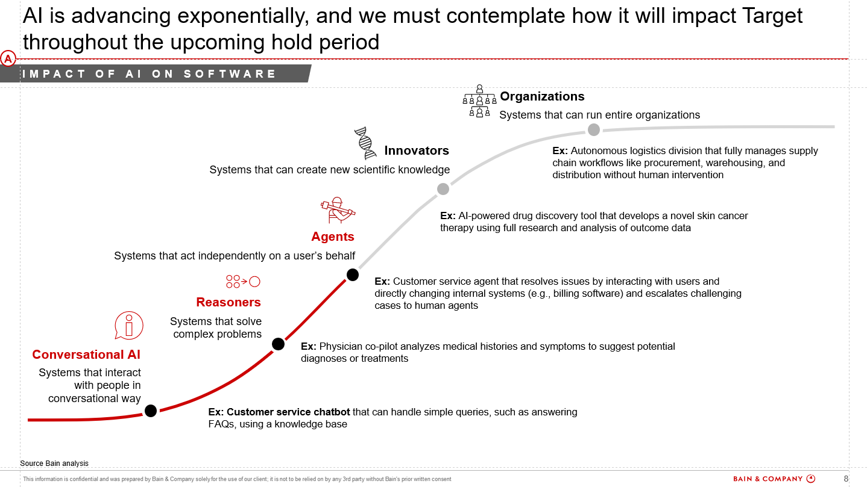
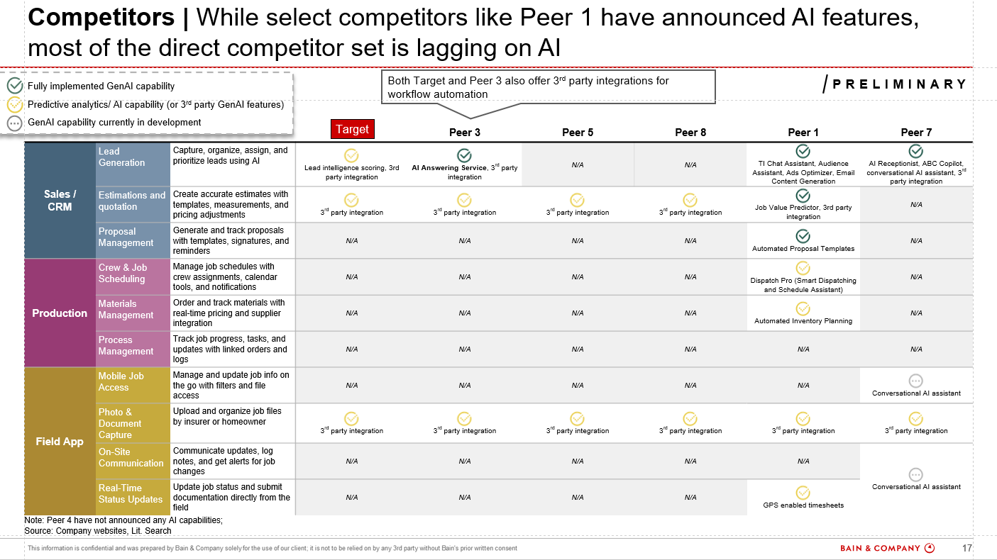
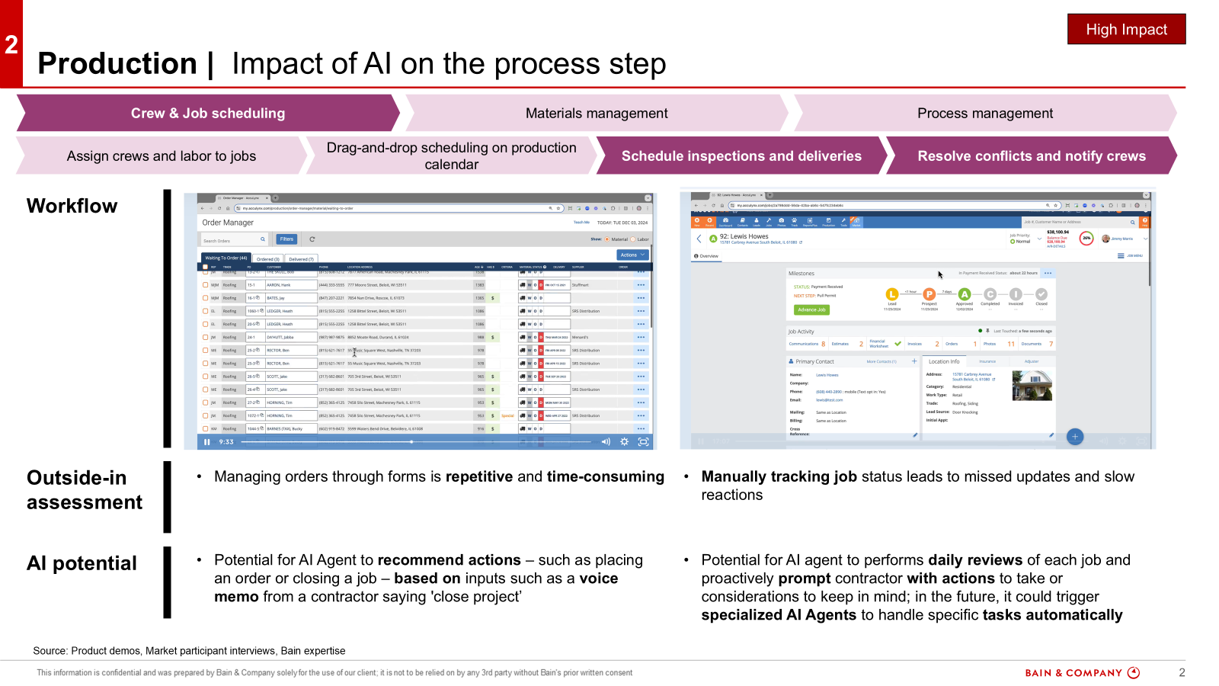
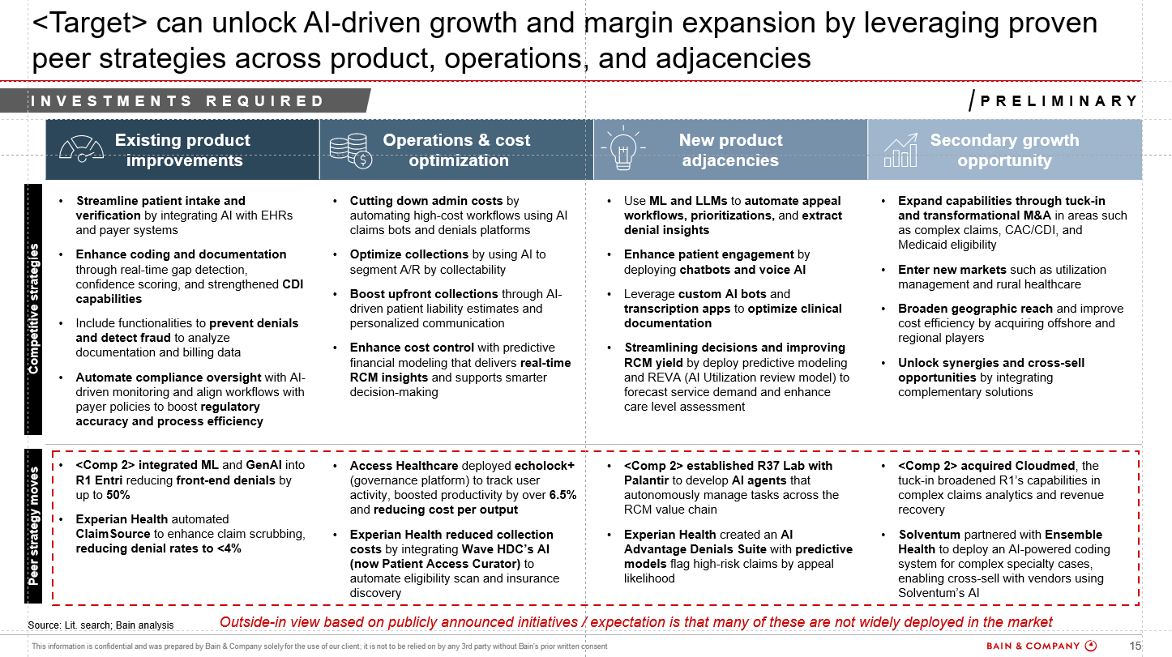
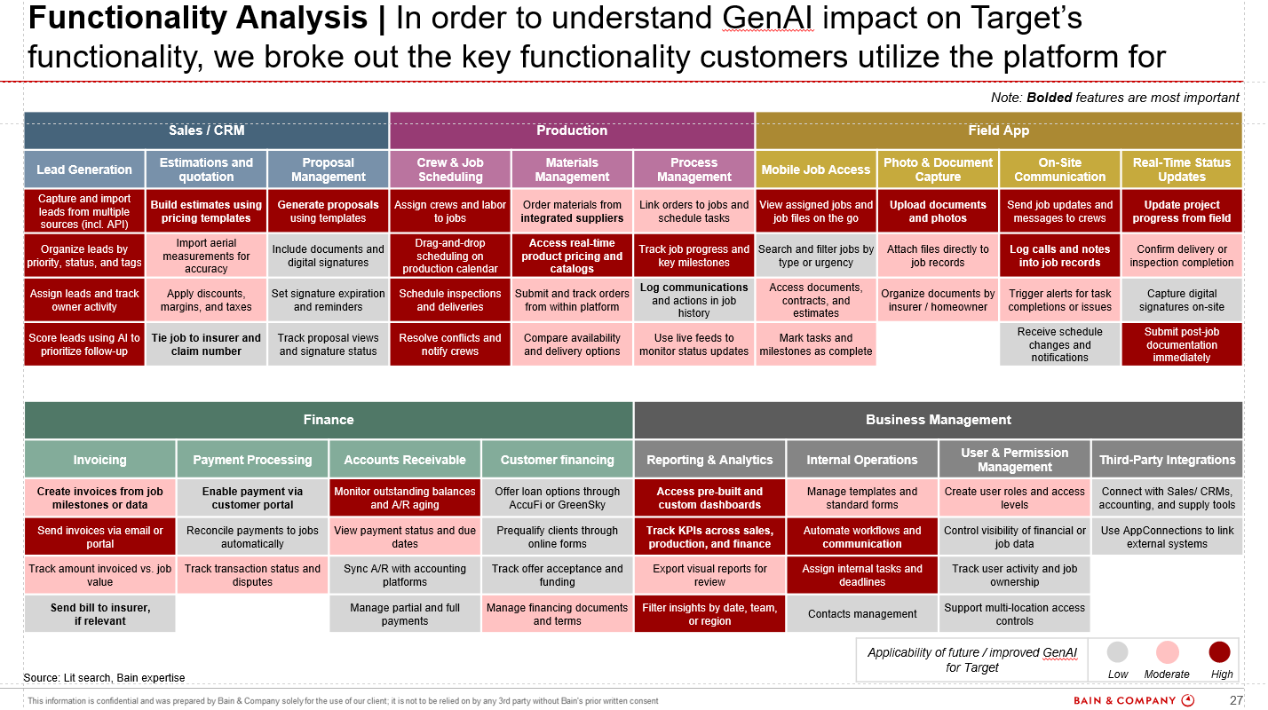
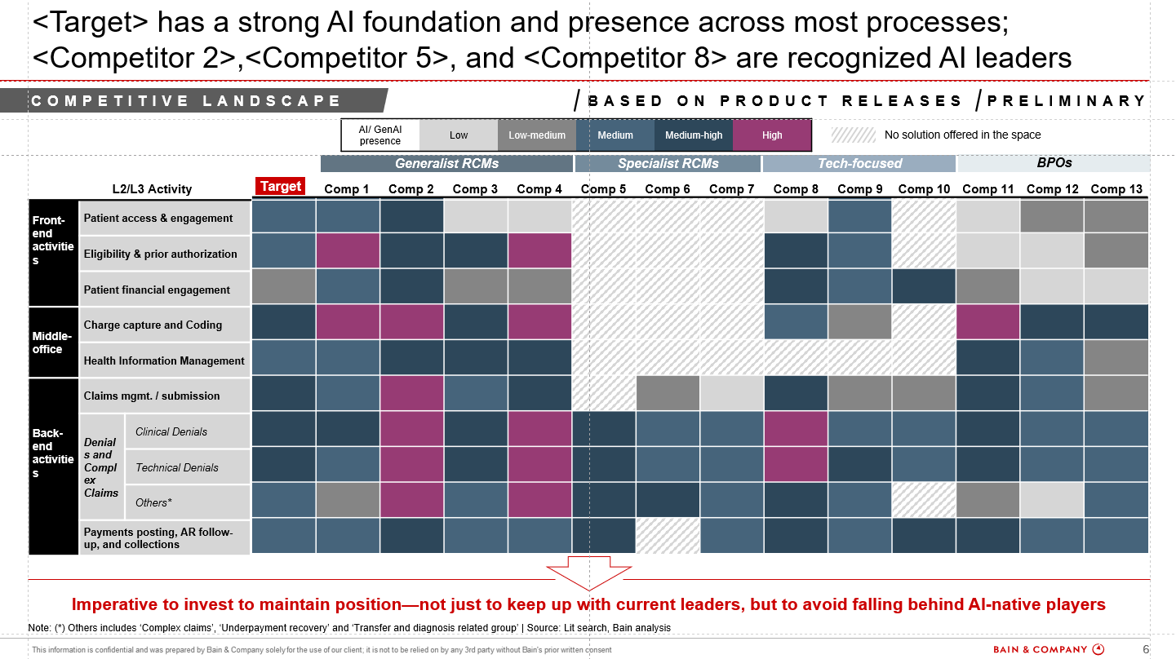
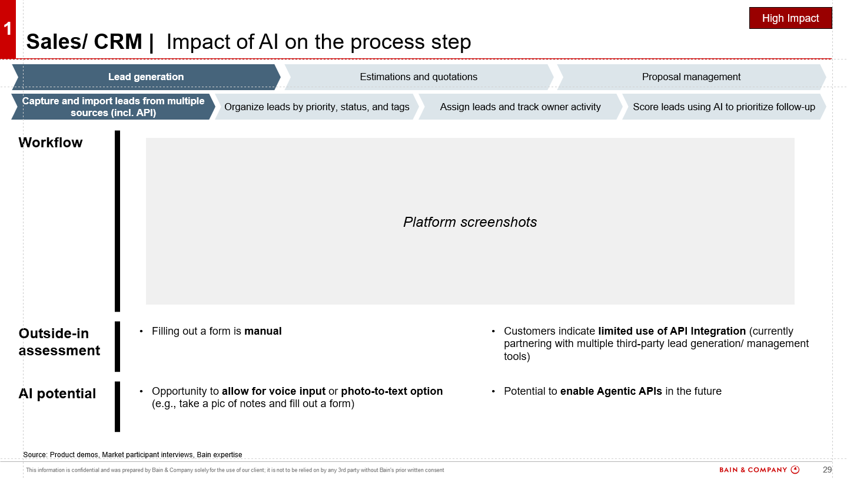
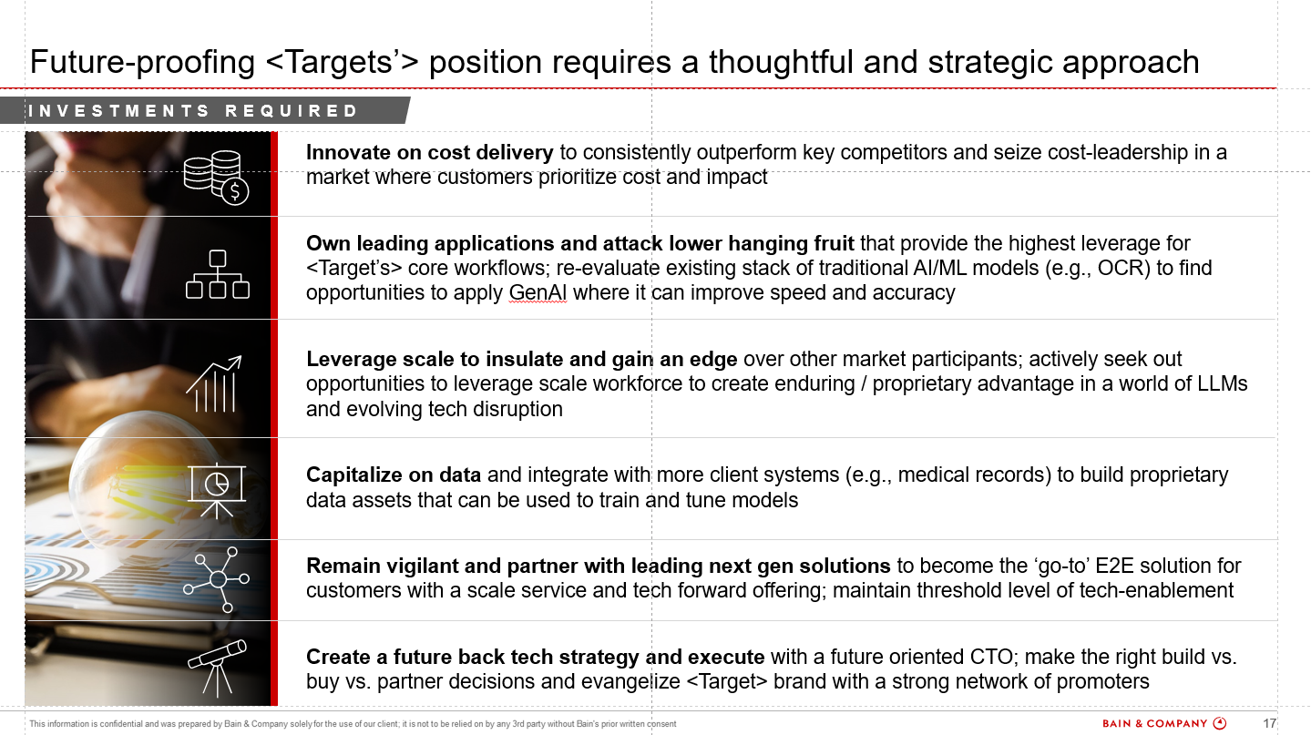
EXECUTIVE SUMMARY
Gen AI
AI Impact and adoption
Competitive scan and benchmarking
AI Tech Replicability
Future strategy and roadmap
Assess how GenAI disrupts the industry dynamics and customer journey by identifying future use cases, adoption drivers, risks, and integration paths
Analyze AI moves by major competitors, including major incumbents and key disruptors. Benchmark target performance and track evolving trends to pinpoint potential threats and whitespace
Test how easily the target’s tech. can be replicated through quick-build AI prototypes. Validate defensibility and real-world relevance of key use cases
Develop an AI-aligned roadmap based on current positioning. Anticipate market shifts and define a clear, phased path to scalable AI adoption

Slide 10





EXECUTIVE SUMMARY
Tech offerings
BCN PEG self-serve tools
Supported platforms and databases
BCN PEG Technology sector offerings
Unlock the power of intuitive self-serve tools for fast, effortless analysis of talent market dynamics, employee perception, software adoption and emerging technology trends!
- AI driven platform to turn raw talent data into interactive insights. Also maps data to standardized output (roles/ seniority/ geography)
- Web-based tool to provide high level talent KPIs and workforce sentiment insights
HG insights - Automated company-wise product usage data with ready-made slides
Developer trends: Leverage developer interest in technologies/ languages to assess technology relevance and growth
Full value chain offering supported with industry-leading tools and global platforms:
Comprehensive technology assessment and competitor benchmarks to identify risks and improvement opportunities
CDD:
Sector profiling and competitive landscape
Customer perception
Digital and ESG assessments
Primary research
TDD:
Product strategy and roadmap
Tech stack and architecture
Organizational model and development process
Cybersecurity assessment
CapEx/ OpEx investments
UI/ UX analysis
DATALAKEAI
HELIXSM
BCN PEG Technology sector offerings provide a holistic view on tech landscape and talent to determine full potential

